Slide 1

Hospital Admission Prediction System
Using Patient Symptoms and Clinical Health Data to enable intelligent, timely, and data-driven admission decisions across modern healthcare institutions.
CLINICAL AI
MACHINE LEARNING
HEALTHCARE ANALYTICS

Slide 2

The Clinical Decision-Making Crisis
Hospitals are overwhelmed. Manual assessments cannot keep pace with rising patient volumes, leading to delayed decisions, inefficient bed allocation, and strained resources.
Rising Patient Volumes
ED visits continue to climb globally, outpacing staffing and infrastructure capacity.
Delayed Decisions
Manual triage introduces critical delays, increasing patient risk and operational costs.
Inefficient Bed Allocation
Without predictive tools, bed management remains reactive rather than proactive.
Resource Constraints
Limited clinical staff must prioritise care without intelligent decision support.

Slide 3


The Proposed Solution
The system predicts hospital admission probability by synthesising multiple clinical data streams into a single, actionable risk score — empowering clinicians to act faster and with greater confidence.
Multi-Parameter Input
ML-Driven Inference
Actionable Insights
Symptoms, demographics, medical history, vital signs, and laboratory results.
Trained models analyse clinical parameters to generate admission probability scores.
Risk stratification and confidence scores support timely, evidence-based decisions.

Slide 4
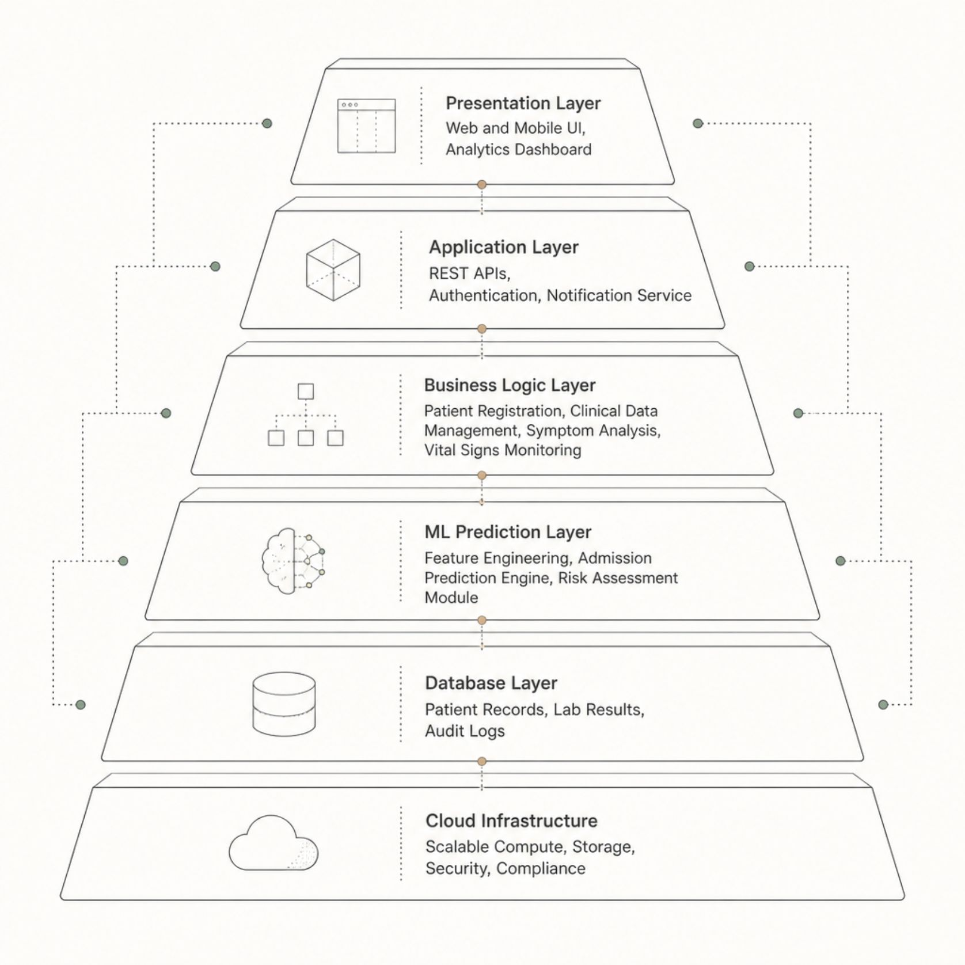
System Architecture
A layered, cloud-native architecture ensures security, scalability, and high availability across all hospital environments.
Key Modules
User Authentication — Role-based access control with audit logging
Clinical Data Management — Unified patient record integration
Admission Prediction Engine — Real-time ML inference pipeline
Analytics Dashboard — Visual risk scores and trend reporting
Notification Service — Alerts for high-risk admissions
Administration Panel — System configuration and user management

Slide 5
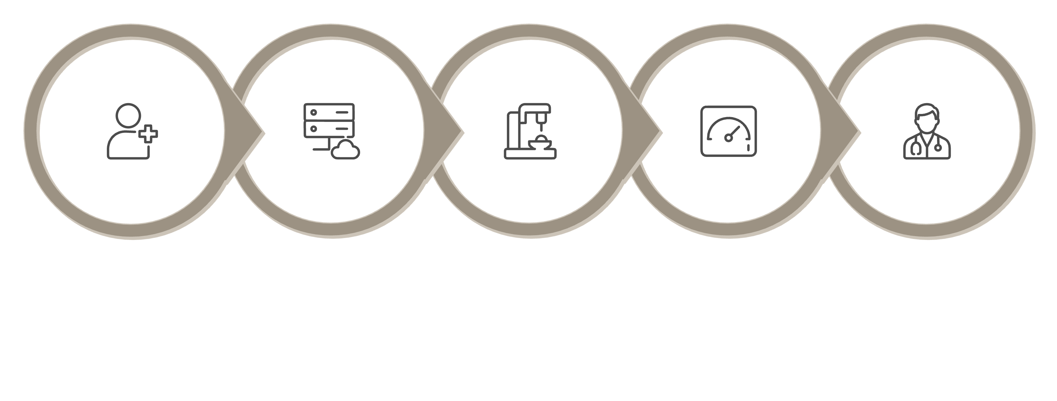
End-to-End Clinical Workflow
Physician Review
Registration
Preprocess
Inference
Dashboard
The workflow begins at patient registration, where symptoms, vitals, and medical history are captured. Data is preprocessed and fed into the ML inference engine, which generates an admission risk score with a confidence interval. Results are visualised on the clinical dashboard for physician review, and outcomes are fed back to continuously retrain and improve model accuracy.

Slide 6
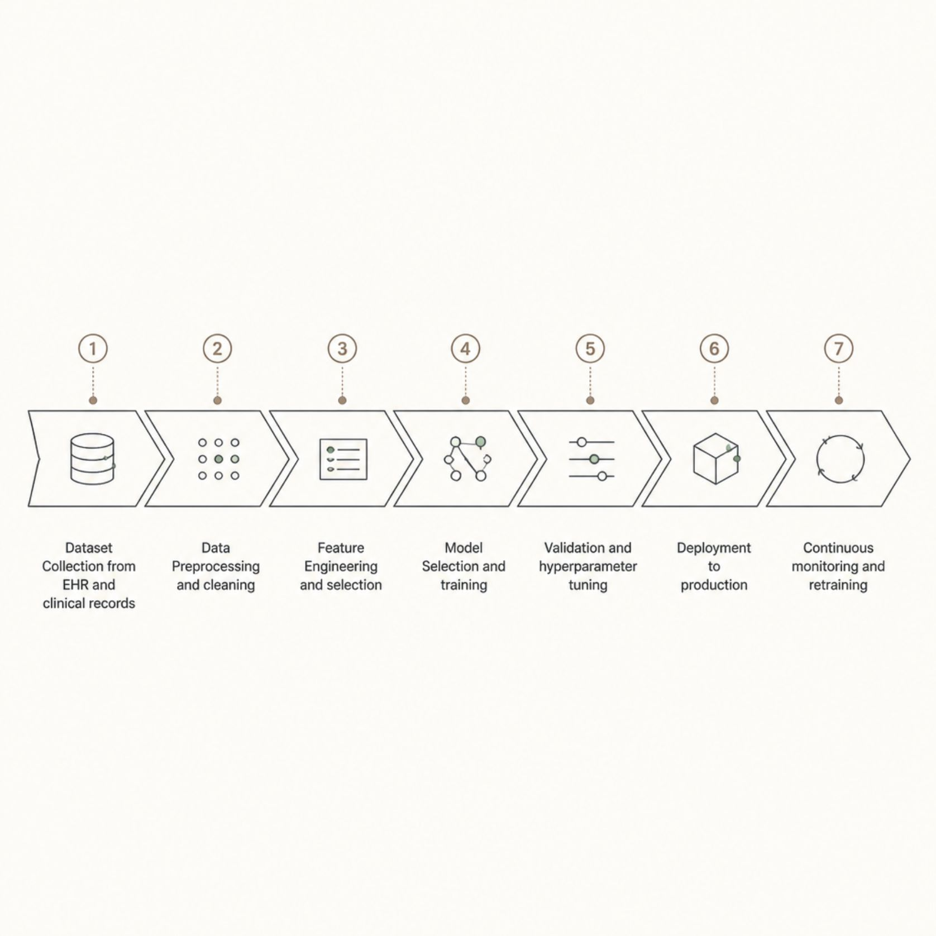
Machine Learning Pipeline
Algorithm Selection
Multiple classification algorithms are evaluated and ensembled for optimal predictive performance:
Logistic Regression & Decision Trees (baseline)
Random Forest & Gradient Boosting
XGBoost & Support Vector Machines
Neural Networks & Ensemble Methods
Evaluation Metrics
Accuracy, Precision, Recall, F1-Score
ROC-AUC, Sensitivity, Specificity
Prediction Confidence & Calibration

Slide 7

Model Performance & Evaluation
Rigorous validation ensures the prediction engine meets clinical-grade reliability standards before and after deployment.
94%
0.97
Prediction Accuracy
ROC-AUC Score
Validated on held-out clinical test datasets
Strong discriminative power for admission classification
<2s
99.9%
Inference Time
System Availability
Real-time prediction suitable for emergency settings
Cloud-native deployment with high-availability architecture
Performance benchmarks are illustrative targets. Actual metrics depend on dataset quality, model configuration, and deployment environment.

Slide 8





Technology Stack
Frontend
React.js / Angular, D3.js for visualisation, responsive mobile-first design
Backend & APIs
Python Flask / FastAPI, RESTful APIs, OAuth2 authentication, JWT tokens
Data Layer
PostgreSQL, Redis cache, HL7/FHIR healthcare data standards
ML & Cloud
Scikit-learn, XGBoost, TensorFlow, AWS / Azure, Docker, Kubernetes

Slide 9
Key Advantages & Real-World Applications
Clinical & Operational Benefits
Deployment Environments
Early identification of patients requiring admission
Optimised bed allocation and resource utilisation
Faster triage and enhanced treatment planning
Reduced administrative workload for clinical staff
Centralised analytics for data-driven hospital management
Emergency departments and trauma centres
Primary healthcare centres and specialty clinics
Telemedicine platforms and remote monitoring
Ambulance services and pre-hospital triage
Public health systems and smart hospital ecosystems

Slide 10
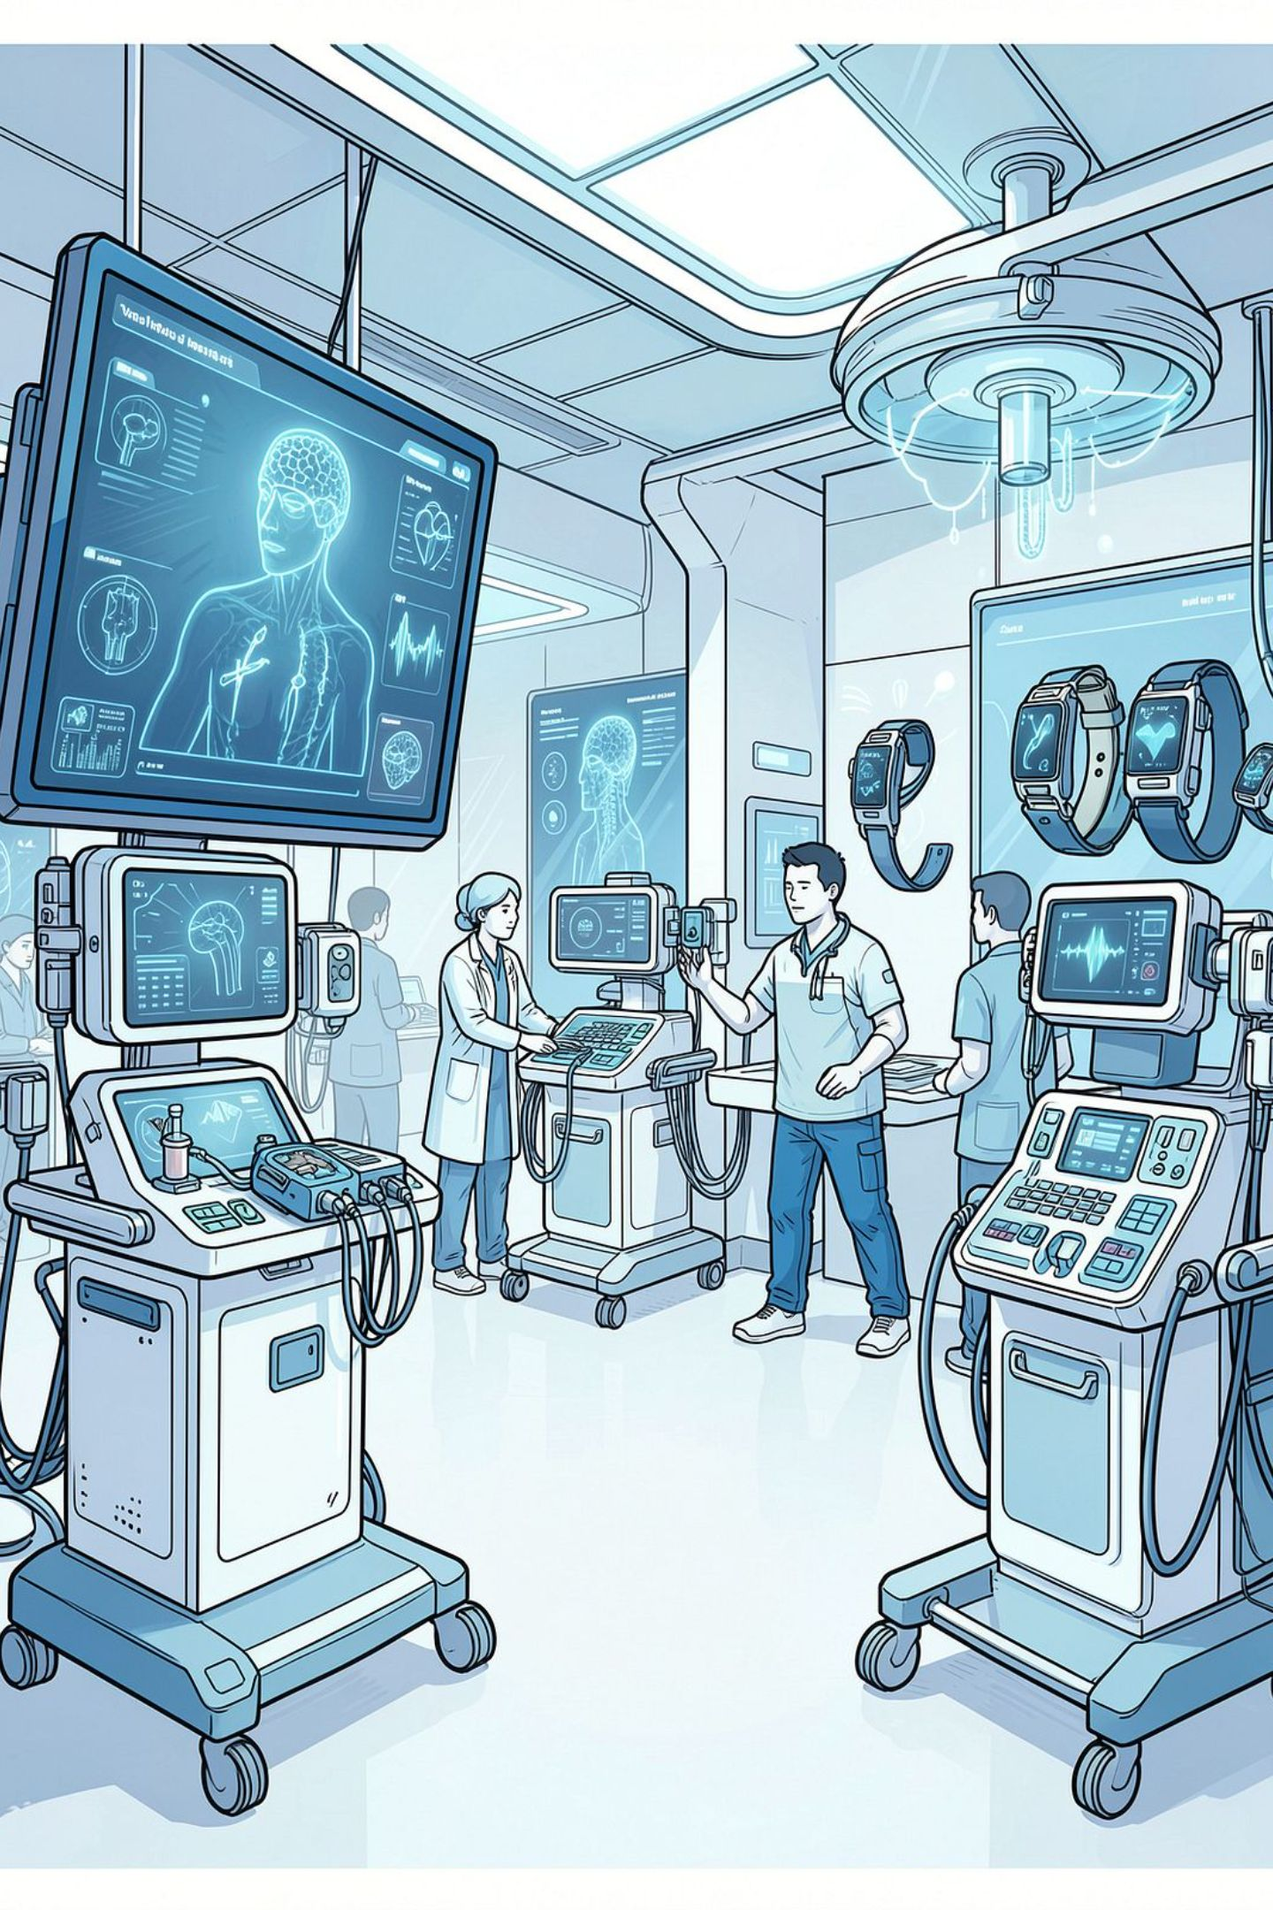

Challenges, Future Roadmap & Conclusion
Implementation Challenges
Patient privacy (HIPAA/GDPR), incomplete records, heterogeneous data integration, AI fairness, and regulatory compliance require careful governance and continuous monitoring.
Future Enhancements
Explainable AI (XAI), EHR integration, wearable device connectivity, real-time monitoring, deep learning models, mobile applications, and multimodal medical data analysis.
Conclusion
This system leverages machine learning and clinical data to accurately predict admission needs, optimise resources, support timely intervention, and enable data-driven decisions for modern healthcare.

